Slide 1
Probabilistic Reasoning
UNIT 4

Slide 2
Probabilistic reasoning in Artificial intelligence
Representing knowledge in an uncertain domain
Uncertainty:
It refers to situation where there is lack of complete information or knowledge about aspect, leading to ambiguity & unpredictability.
So to represent uncertain knowledge, where we are not sure about the predicates, we need uncertain reasoning or probabilistic reasoning.

Slide 3
Causes of uncertainty:
Following are some leading causes of uncertainty to occur in the real world.
Information occurred from unreliable sources.
Experimental Errors
Equipment fault
Temperature variation
Climate change.

Slide 4
Probabilistic reasoning:
Probabilistic reasoning is a way of knowledge representation where we apply the concept of probability to indicate the uncertainty in knowledge.
In probabilistic reasoning, we combine probability theory with logic to handle the uncertainty.
We use probability in probabilistic reasoning because it provides a way to handle the uncertainty that is the result of someone's laziness and ignorance.

Slide 5
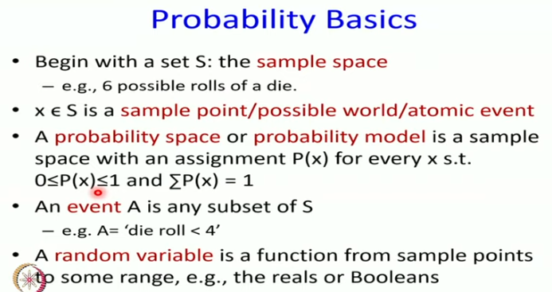

Slide 6
Need of probabilistic reasoning in AI:
When there are unpredictable outcomes.
When specifications or possibilities of predicates becomes too large to handle.
When an unknown error occurs during an experiment.

Slide 7
In probabilistic reasoning, there are two ways to solve problems with uncertain knowledge:
Bayes' rule
Bayesian Statistics

Slide 8
Probability:
Probability can be defined as a chance that an uncertain event will occur.
It is the numerical measure of the likelihood that an event will occur.
The value of probability always remains between 0 and 1 that represent ideal uncertainties

Slide 9
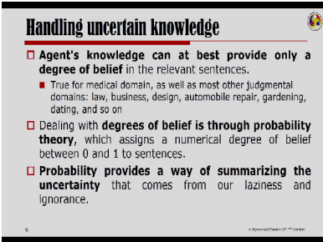

Slide 10
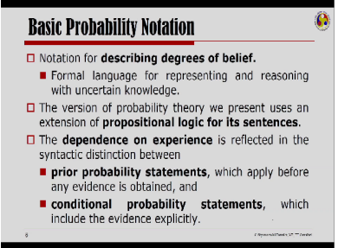

Slide 11
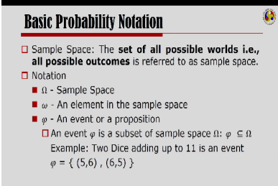

Slide 12
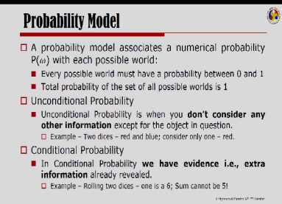

Slide 13
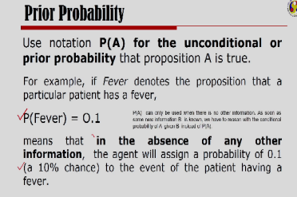

Slide 14
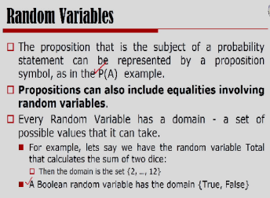

Slide 15
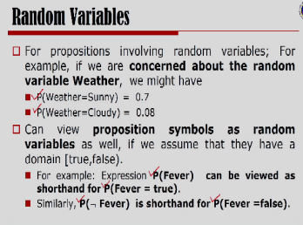

Slide 16
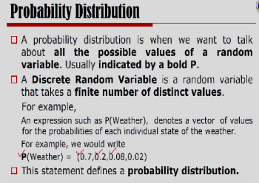

Slide 17
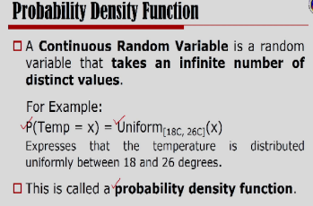

Slide 18
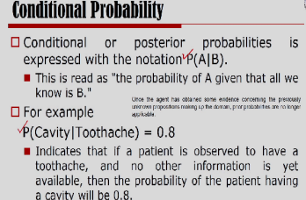

Slide 19
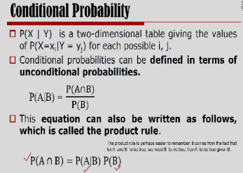

Slide 20
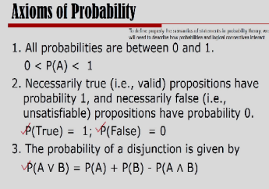

Slide 21
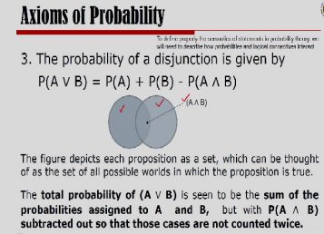

Slide 22
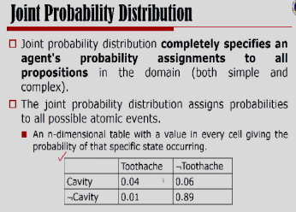

Slide 23
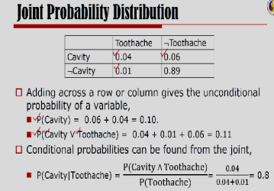

Slide 24
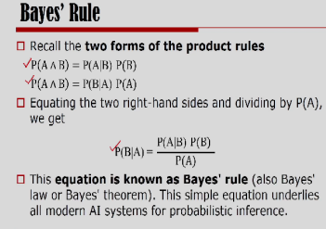

Slide 25
Event: Each possible outcome of a variable is called an event.
Sample space: The collection of all possible events is called sample space.
Random variables: Random variables are used to represent the events and objects in the real world.
Prior probability: The prior probability of an event is probability computed before observing new information.
Posterior Probability: The probability that is calculated after all evidence or information has taken into account. It is a combination of prior probability and new information

Slide 26
Bayesian Networks
Bayesian network is a data structure to represent an uncertain knowledge or domain.
It is a directed acyclic graph whose nodes correspond to random variables.
Each node is annotated with conditional probability distribution for the node given it’s parents.
Bayesian networks, often abbreviated as “Bayes net” were called belief networks in the 1980s and 1990s.

Slide 27
Bayesian Networks
Each node corresponds to a random variable, which may be discrete or continuous
Directed links or arrows connects pair of nodes. If there is an arrow from node X to node Y, X is said to be a parent of Y.
The graph has no directed cycles and hence it is a directed acyclic graph or DAG
Each node Xi has associated probability information θ(Xi|Parents(Xi)) that quantifies the effects of the parents on the node using a finite number of parameters.

Slide 28
Topology of Bayesian network
The set of nodes and links specifies the conditional independence relationships that hold in the domain.
The intuitive meaning of the arrow is typically that X has a direct influence on Y, which suggests that causes should parents of effects. It is usually easy for the domain expect to decide which relationships exists in the domain.
Once the topology is laid out, local probability information is provided for each node/variable in the form of conditional probability given its parents.
The full joint distribution for all the variables is defined by the topology and the local probability information.

Slide 29
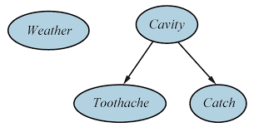
Topology of Bayesian network

Slide 30
Bayesian Networks
A simple Bayesian network in which Weather is independent of of the other 3 variables.
Toothache and Catch are conditionally independent , given Cavity. This is indicated by the absence of link between Toothache and Catch.
It also indicates that Cavity is the direct cause of Toothache and Catch, whereas no direct causal relationship exists between Toothache and Catch.

Slide 31
Bayesian Networks
Real world applications are probabilistic in nature, and to represent the relationship between multiple events, we need a Bayesian network.
It can also be used in various tasks including prediction, anomaly detection, diagnostics, automated insight, reasoning, time series prediction, and decision making under uncertainty.
Bayesian Network can be used for building models from data and experts opinions, and it consists of two parts:
Directed Acyclic Graph
Table of conditional probabilities.
The generalized form of Bayesian network that represents and solve decision problems under uncertain knowledge is known as an Influence diagram.

Slide 32
Bayesian Networks
A Bayesian network is a probabilistic graphical model which represents a set of variables and their conditional dependencies using a directed acyclic graph."
It is also called a Bayes network, belief network, decision network, or Bayesian model.
Bayesian networks are probabilistic, because these networks are built from a probability distribution, and also use probability theory for prediction and anomaly detection.

Slide 33
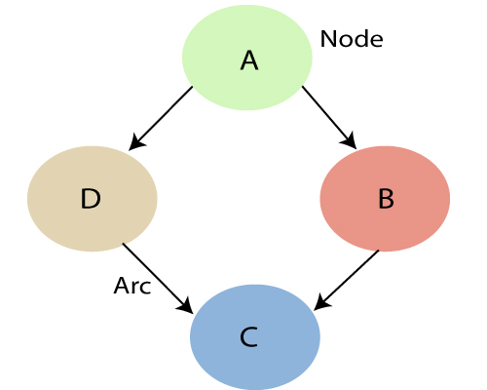

Slide 34
Each node corresponds to the random variables, and a variable can be continuous or discrete.
Arc or directed arrows represent the causal relationship or conditional probabilities between random variables. These directed links or arrows connect the pair of nodes in the graph. These links represent that one node directly influence the other node, and if there is no directed link that means that nodes are independent with each other
In the above diagram, A, B, C, and D are random variables represented by the nodes of the network graph.
If we are considering node B, which is connected with node A by a directed arrow, then node A is called the parent of Node B.
Node C is independent of node A.

Slide 35
Each node in the Bayesian network has condition probability distribution P(X_{i} |Parent(X_{i}) ), which determines the effect of the parent on that node.
Bayesian network is based on Joint probability distribution and conditional probability.

Slide 36
how to create a Bayesian network
Assume your house has an alarm system against burglary.
You live in the seismically active area and the alarm system can get occasionally set off by an earthquake.
You have two neighbors, Mary and John, who do not know each other.
If they hear the alarm they call you, but this is not guaranteed.
We want to represent the probability distribution of events: – Burglary, Earthquake, Alarm, Mary calls and John calls

Slide 37
Bayesian network
Directed acyclic graph
Nodes = random variables
Burglary, Earthquake, Alarm, Mary calls and John calls
Links = direct (causal) dependencies between variables.
The chance of Alarm is influenced by Earthquake, The chance of John calling is affected by the Alarm

Slide 38
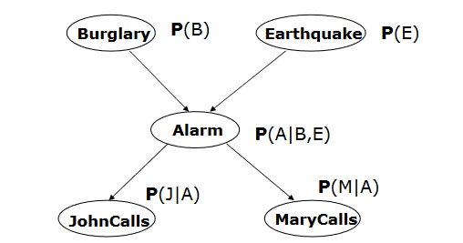

Slide 39
2. Local conditional distributions
• Relate variables and their parents
• The local probability information attached to each node takes the form of a conditional probability table (CPT).
• Each row in the CPT contains the conditional probability of each node value for conditioning case. A conditioning case is just the possible combination of values for the parent nodes.
• Each row must sum to 1, because the entries represent an exhaustive set of cases for the variable.

Slide 40
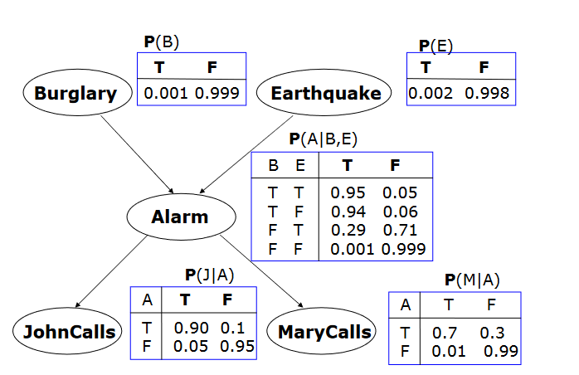

Slide 41
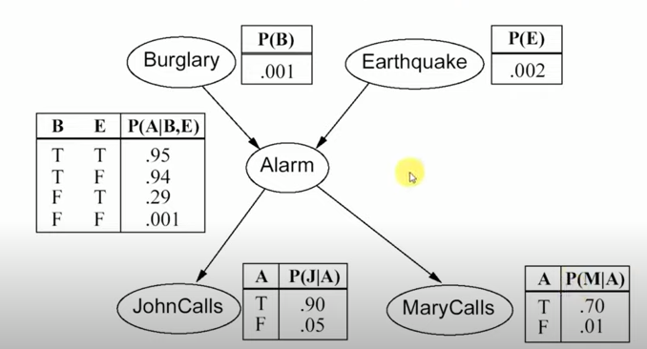

Slide 42


Slide 43
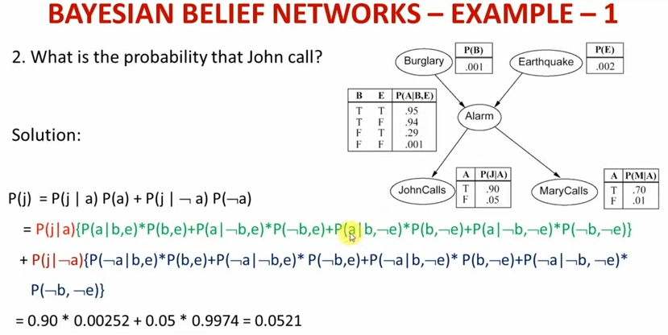

Slide 44
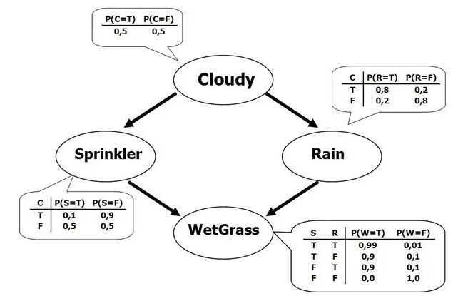

Slide 45
P(j,m,a, ¬b, ¬e) = P(j|a)P(m|a)P(a|¬b,¬e)P(¬b)P(¬e) = 0.90 x 0.70 x 0.001 x 0.999 x 0.998 = 0.000628

Slide 46
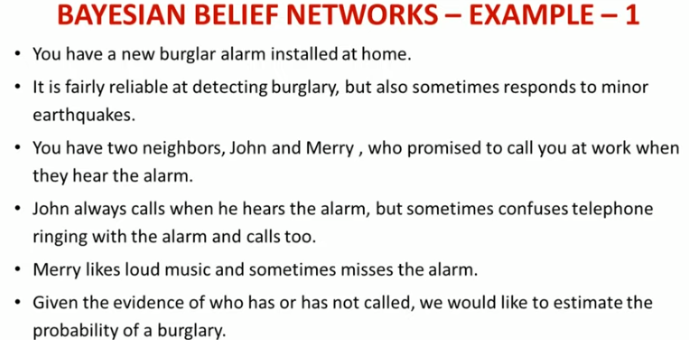

Slide 47
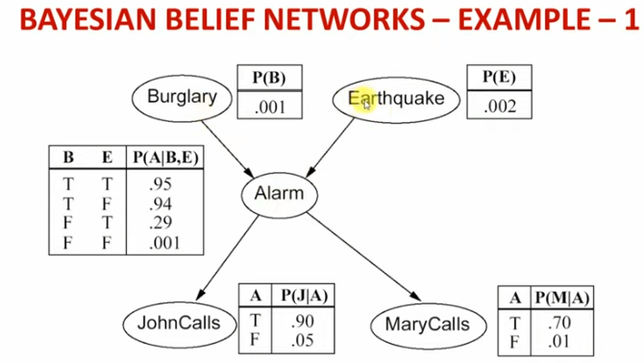

Slide 48
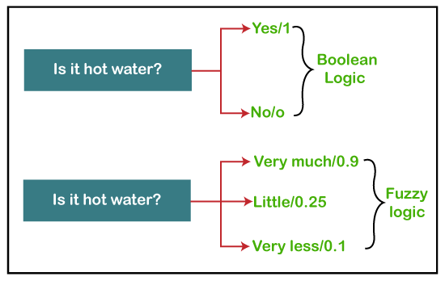
What is Fuzzy Logic?
The 'Fuzzy' word means the things that are not clear or are vague.

Slide 49
Fuzzy Logic
Fuzzy logic contains the multiple logical values and these values are the truth values of a variable or problem between 0 and 1.
This concept was introduced by Lofti Zadeh in 1965 based on the Fuzzy Set Theory.
This concept provides the possibilities which are not given by computers, but similar to the range of possibilities generated by humans.
Fuzzy Logic (FL) is a method of reasoning that resembles human reasoning.
The approach of FL imitates the way of decision making in humans that involves all intermediate possibilities between digital values YES and NO.

Slide 50
Implementation
It can be implemented in systems with various sizes and capabilities ranging from small micro-controllers to large, networked, workstation-based control systems.
It can be implemented in hardware, software, or a combination of both.
It can control machines and consumer products.
It may not give accurate reasoning, but acceptable reasoning.
Fuzzy logic helps to deal with the uncertainty in engineering.

Slide 51
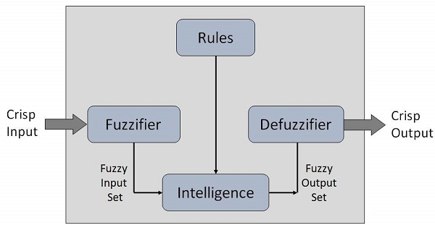
Architecture of a Fuzzy Logic System

Slide 52
Membership Function
Membership functions allow you to quantify linguistic term and represent a fuzzy set graphically.
A membership function for a fuzzy set A on the universe of discourse X is defined as μ_{A}:X → [0,1].
Here, each element of X is mapped to a value between 0 and 1.
It is called membership value or degree of membership.
It quantifies the degree of membership of the element in X to the fuzzy set A.

Slide 53
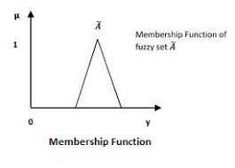
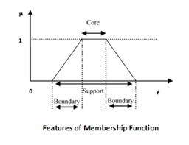

Slide 54
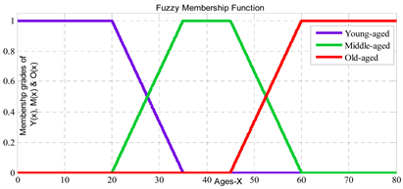

Slide 55
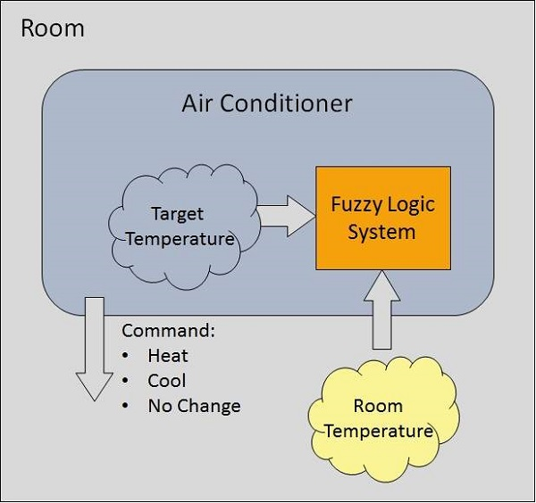
Example of a Fuzzy Logic System

Slide 56
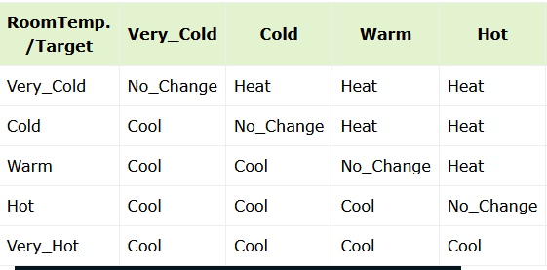

Slide 57
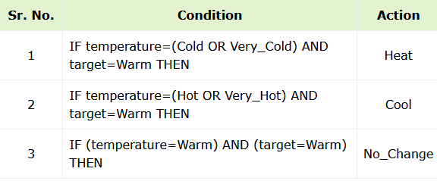

Slide 58
Classical Set
Set of Natural Numbers: N={1, 2, 3, 4, 5, 6, 7, ......,n).
A = {x:p(x)}
B = {x:2 ≤ x < 20 and (x%2) = 0}
Operations on Classical Set
Union Operation A ∪ B = { x | x ∈ A OR x ∈ B }.
Intersection Operation A ∩ B = { x | x ∈ A AND x ∈ B }.
Difference Operation A - B = { x | x ∈ A AND x ∉ B }.
Complement Operation A′ = {x|x ∉ A}.

Slide 59
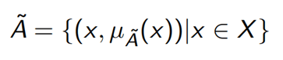
Fuzzy Set
A fuzzy set is a collection of values which exist between 0 and 1.

Slide 60
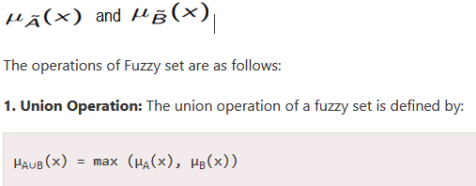
Operations on Fuzzy Set
Given Ã and B are the two fuzzy sets, and X be the universe of discourse with the following respective member functions:

Slide 61
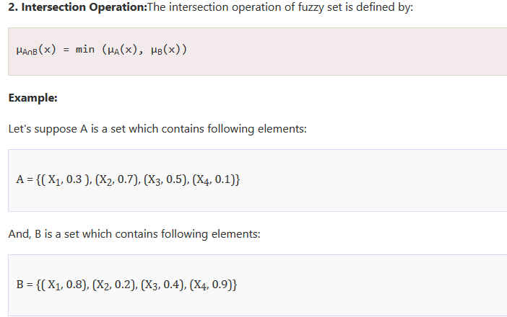

Slide 62
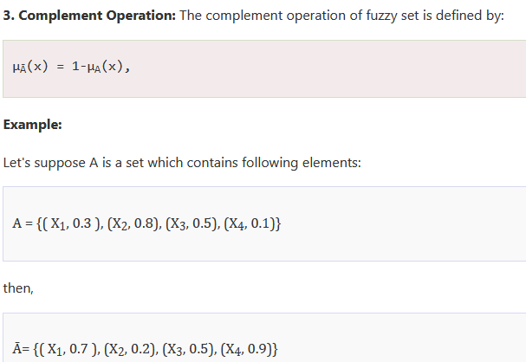

Slide 63
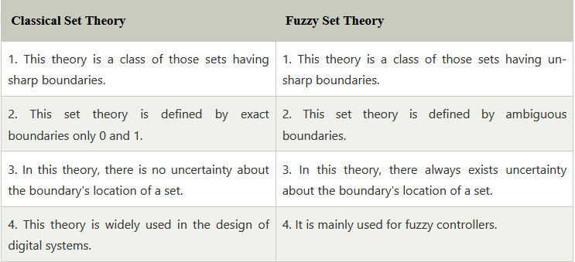

Slide 64
Advantages of Fuzzy Logic
The methodology of this concept works similarly as the human reasoning.
Any user can easily understand the structure of Fuzzy Logic.
It does not need a large memory, because the algorithms can be easily described with fewer data.
It is widely used in all fields of life and easily provides effective solutions to the problems which have high complexity.
This concept is based on the set theory of mathematics, so that's why it is simple.

Slide 65
Disadvantages of Fuzzy Logic
The run time of fuzzy logic systems is slow and takes a long time to produce outputs.
The possibilities produced by the fuzzy logic system are not always accurate.
Many researchers give various ways for solving a given statement using this technique which leads to ambiguity.
Fuzzy logics are not suitable for those problems that require high accuracy.
The systems of a Fuzzy logic need a lot of testing for verification and validation.

Slide 66
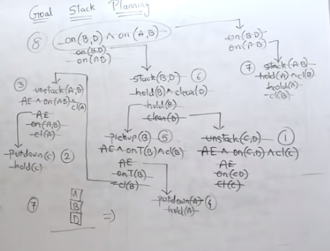

Slide 67
What is the Role of Planning in Artificial Intelligence?
Planning is a critical part of Artificial Intelligence which deals with the actions and domains of a particular problem.
Planning is considered as the reasoning side of acting.
Everything we humans do is with a certain goal in mind and all our actions are oriented towards achieving our goal.
In a similar fashion, planning is also done for Artificial Intelligence.

Slide 68
What is the Role of Planning in Artificial Intelligence?
For example, reaching a particular destination requires planning. Finding the best route is not the only requirement in planning, but the actions to be done at a particular time and why they are done is also very important.
That is why planning is considered as the reasoning side of acting.
planning is all about deciding the actions to be performed by the Artificial Intelligence system and the functioning of the system on its own in domain-independent situations.

Slide 69
What is a Plan?
For any planning system, we need the domain description, action specification, and goal description.
A plan is assumed to be a sequence of actions and each action has its own set of preconditions to be satisfied before performing the action and also some effects which can be positive or negative.
So, we have Forward State Space Planning (FSSP) and Backward State Space Planning (BSSP) at the basic level.

Slide 70
What is planning in AI?
Planning in artificial intelligence is about decision-making actions performed by robots or computer programs to achieve a specific goal.
Execution of the plan is about choosing a sequence of tasks with a high probability of accomplishing a specific task.

Slide 71
Forward State Space Planning (FSSP)
Because it moves in a forward direction, forward state-space search is also known as progression planning.
We begin in the problem's initial state and explore action sequences until we discover one that leads to a target state.
The following is a description of planning issues as state-space search problems:
Initial state: The search's initial state is the planning problem's starting state. In general, each state is a collection of positive ground literals;

Slide 72
Forward State Space Planning (FSSP)
Action State: All actions that are appropriate to a state satisfy all of the prerequisites.
The succeeding state produced by action is created by adding positive effect literals and removing negative effect literals.
Goal: The goal test determines whether the state meets the planning problem's aim.
Step Cost: Each action usually has a step cost of one. Although it would be simple to enable various costs for different activities, STRIPS planners rarely do so.

Slide 73
Forward State Space Planning (FSSP)
FSSS (forward state-space search) begins in the initial state and takes steps to progress to the next state. It then determines whether or not this state is the target condition. If not, it will continue to take other steps until the objective is met.
Advantage
The algorithm's soundness is one of its advantages.
Disadvantage
Extensive branching is a disadvantage.

Slide 74
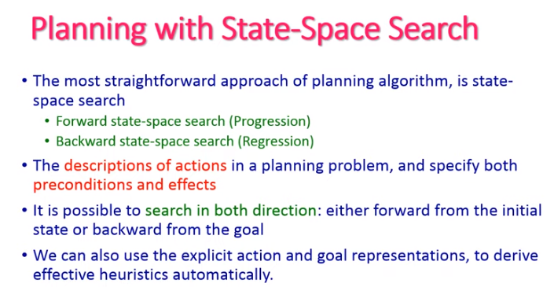

Slide 75
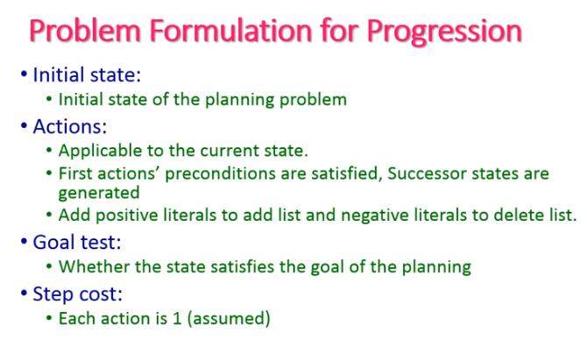

Slide 76
Backward State Space Planning (BSSP)
Backward State Space Planning (BSSP) is analogous to Backward state-space search.
This moves us from goal state g to sub-goal g', which determines the prior action needed to achieve that goal.
This is known as decline (moving back to the previous goal or sub-goal).
The uniformity of these sub-goals needs to be investigated. In this case, the actions must be relevant.

Slide 77
Backward State Space Planning (BSSP)
Advantage
Backward search has the primary benefit of allowing us to examine only pertinent activities, thereby reducing branching.
Disadvantage
The algorithm's soundness is one of its disadvantages.

Slide 78
The Planning Language (STRIPS)
STRIPS(Stanford Research Institute Problem Solver) is frequently used to represent planning problems in AI.
The STRIPS representation was selected to simplify and improve planning algorithms without having it too hard to explain real-world issues. It is composed of:
Set of states- It is a positive ground literal combination.
Set of goals- A partly defined state depicted as a combination of positive literals collection
Set of actions- For every action, there is a prerequisite that must be met and an effect that represents the influence the action has on the surroundings after it has been done.

Slide 79
Goal Stack Planning
Goal Stack planning is among the most important planning methods, which is employed solely by STRIPS.
The stack is employed by algorithms to store actions and guarantee that the goal is fulfilled.
A knowledge base is employed to keep track of the present status and activities.
A goal stack is similar to a component in a search tree, in which branches develop when an action is chosen.

Slide 80
The Important Steps of the Algorithm
Start by pushing the original target onto the stack. Repeat this until the pile is empty. If the stack top is a mixed target, push its unsatisfied sub-targets onto the stack.
If the stack top is a single unsatisfied target, replace it with action and push the action precondition to the stack to satisfy the condition.
If the stack top is an action, pop it off the stack, execute it and replace the knowledge base with the action's effect.
If the stack top is a satisfactory target, pop it off the stack.

Slide 81
Block-World Planning Problem
The blocks world is among the most well-known planning techniques in AI. This domain is made up of a collection of cube-shaped pieces arranged on a table (as shown in the figure). Although the blocks can be piled, only one can be placed immediately on top of another. A robot arm can take up a block and transfer it to a different location on the surface or top of another block. Because the arm can only take up one block at a time, it cannot lift a block with another one on it. The objective will always be to construct one or more piles of blocks, which will be described in terms of which blocks are on top of which other blocks.

Slide 82
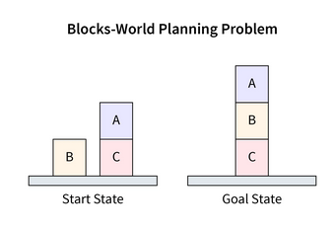

Slide 83
Components of the Planning System
Using the most effective known heuristics, choose the most suitable rule for implementing the next rule.
Use the selected algorithm to compute the new problem state.
Determine when an answer has been discovered.
Identify dead ends to ensure the system's effort can be guided in more productive ways.
Determine when a nearly correct solution has been discovered.

Slide 84
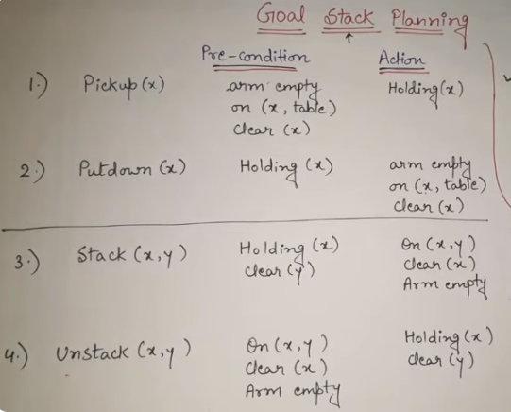

Slide 85
Example : Blocks World
STRIPS : A planning system – Has rules with precondition deletion list and addition list
Robot hand
A
Robot hand
C
B
A
B
C
START
GOAL
Sequence of actions :
Grab C
Pickup C
Place on table C
Grab B
Pickup B
6. Stack B on C
Grab A
Pickup A
Stack A on B

Slide 86
Example : Blocks World
Fundamental Problem :
The frame problem in AI is concerned with the question of what piece of knowledge is relevant to the situation.
Fundamental Assumption : Closed world assumption
If something is not asserted in the knowledge base, it is assumed to be false.
(Also called “Negation by failure”)

Slide 87
Example : Blocks World
STRIPS : A planning system – Has rules with precondition deletion list and addition list
Robot hand
A
Robot hand
C
B
A
B
C
START
GOAL
on(B, table)
on(A, table)
on(C, A)
hand empty
clear(C)
clear(B)
on(C, table)
on(B, C)
on(A, B)
hand empty
clear(A)

Slide 88
Rules
R1 : pickup(x)
Precondition & Deletion List : hand empty, on(x,table), clear(x)
Add List : holding(x)
R2 : putdown(x)
Precondition & Deletion List : holding(x)
Add List : hand empty, on(x,table), clear(x)

Slide 89
Rules
R3 : stack(x,y)
Precondition & Deletion List :holding(x), clear(y) Add List : on(x,y), clear(x)
R4 : unstack(x,y)
Precondition & Deletion List : on(x,y), clear(x)
Add List : holding(x), clear(y)

Slide 90
Plan for the block world problem
For the given problem, Start → Goal can be achieved by the following sequence :
Unstack(C,A)
Putdown(C)
Pickup(B)
Stack(B,C)
Pickup(A)
Stack(A,B)
Execution of a plan: achieved through a data structure called Triangular Table.

Slide 91
Triangular Table
on(C,A)
1
clear(C)
hand empty
unstack(C,A)
2
holding(C)
putdown(C)
on(B,table)
hand empty
pickup(B)
3
4
clear(C)
holding(B)
stack(B,C)
on(A,table)
clear(A)
hand empty
pickup(A)
5
6
clear(B)
holding(A)
stack(A,B)
on(C,table)
on(B,C)
on(A,B)
7
clear(A)
0
1
2
3
4
5
6

Slide 92
Hierarchical Planning in Artificial Intelligence
A method used in artificial intelligence (AI) called hierarchical planning involves dividing a big problem into a hierarchy of smaller, more manageable sub-problems.
The results are then combined to find a solution for the primary problem once each subproblem has been individually solved.
This methodology has been used in a number of AI fields, such as robotics, scheduling, and game playing.
It entails segmenting a huge problem into smaller subproblems, resolving each subproblem separately, and then incorporating the solutions into the larger problem.

Slide 93
Hierarchical Planning in Artificial Intelligence
In hierarchical planning, the high-level task is represented as the ultimate goal, and it is decomposed into subgoals or actions at lower levels of the hierarchy.
The hierarchy can be organized as a tree or a directed acyclic graph (DAG), with the high-level goal as the root node and the lowest-level tasks or actions as leaf nodes.
Planning can occur at different levels of the hierarchy, with the system selecting goals and generating plans for achieving subgoals or actions.
The plans generated at different levels are then synthesized into a cohesive plan for execution.

Slide 94
Components of Hierarchical Planning
High-level goals: The overall objectives or tasks that the AI system aims to achieve.
Task decomposition: Breaking down high-level goals into lower-level tasks or subgoals.
Planning hierarchy: The organization of tasks or subgoals into a hierarchical structure, such as a tree or a directed acyclic graph (DAG).
Plan generation at different levels: Reasoning and planning at different levels of the hierarchy, with plans generated for achieving subgoals or actions.

Slide 95
Components of Hierarchical Planning
Plan synthesis: Combining the plans for achieving subgoals or actions into a cohesive plan for execution.
Plan execution: Carrying out the actions or subgoals in the plan in the correct order.
Plan adaptation: Revising plans at different levels of abstraction to accommodate changes in the environment or goals.

Slide 96
Definition of Hierarchical Planning
Hierarchical planning refers to a problem-solving approach that involves breaking down complex tasks into a hierarchical structure of smaller sub-tasks or actions that can be executed by an intelligent agent.
The agent decomposes the overall task into sub-tasks and generates a plan for each sub-task, taking into account dependencies, constraints, and the goals of the overall task. Each sub-plan is executed sequentially, with the results of each step being used to guide subsequent steps.

Slide 97
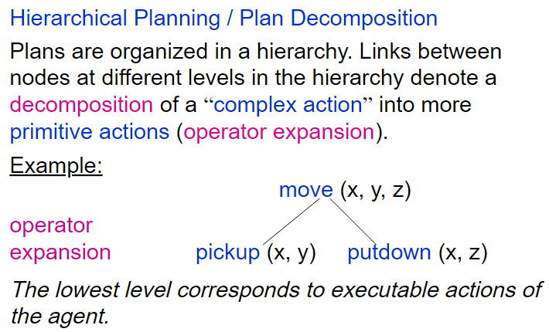

Slide 98
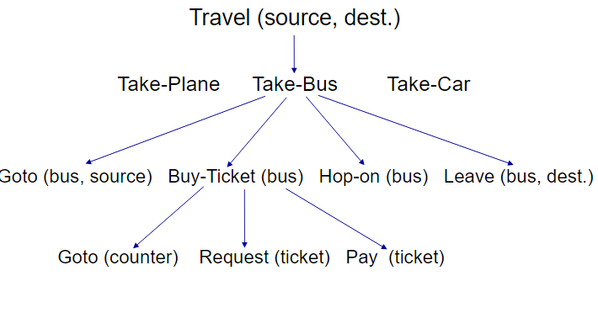

Slide 99
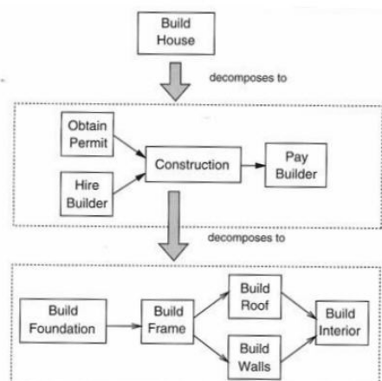

Slide 100
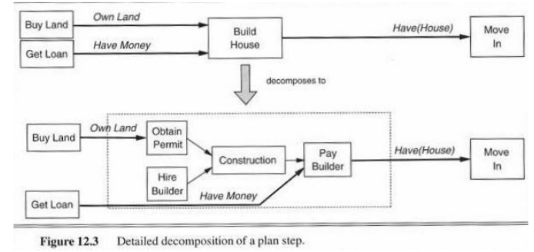

Slide 101
Techniques Used in Hierarchical Planning
Decomposition techniques:
Decomposition techniques involve breaking down high-level goals or tasks into lower-level tasks or subgoals.
This can be done using methods such as goal decomposition, task network decomposition, or state-based decomposition.
Goal decomposition involves breaking down high-level goals into smaller subgoals that can be achieved independently.

Slide 102
Decomposition techniques:
Task network decomposition involves representing tasks and their dependencies as a directed graph and decomposing it into smaller subgraphs.
State-based decomposition involves dividing the planning problem into smaller subproblems based on different states of the environment.

Slide 103
Hierarchical Task Network (HTN)
In artificial intelligence, the hierarchical task network, or HTN, is an approach to automated planning in which the dependency among actions can be given in the form of networks.
Planning problems are specified in the hierarchical task network approach by providing a set of tasks, which can be:
primitive tasks, which roughly correspond to the actions of STRIPS;
compound tasks, which can be seen as composed of a set of simpler tasks;
goal tasks, which roughly corresponds to the goals of STRIPS, but are more general.

Slide 104
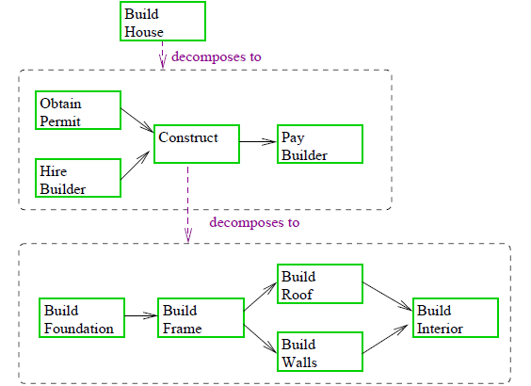

Slide 105
A primitive task is an action that can be executed.
A compound task is a complex task composed of a sequence of actions. A goal task is a task of satisfying a condition.
The difference between primitive and other tasks is that the primitive actions can be directly executed.
Compound and goal tasks both require a sequence of primitive actions to be performed;
however, goal tasks are specified in terms of conditions that have to be made true,
while compound tasks can only be specified in terms of other tasks via the task network outlined below.

Slide 106
Why do we require Hierarchical Planning?
Breaking down large problems:
Efficient use of resources:
Handling uncertainty:
Flexibility

Slide 107
Advantages of Hierarchical Planning
Scalability: Hierarchical planning allows for reasoning and planning at different levels of abstraction, enabling efficient handling of complex tasks and environments.
Flexibility: Hierarchical planning provides the flexibility to adapt plans to changes in the environment or goals, making them more robust and adaptable.

Slide 108
Advantages of Hierarchical Planning
Abstraction and reuse: The use of a hierarchy of tasks or subgoals allows for the abstraction and reuse of plans, making planning more efficient and reducing the need for redundant planning.
Higher-level reasoning: Hierarchical planning allows for higher-level reasoning and decision-making, enabling AI systems to make strategic choices and coordinate actions at a higher level of abstraction.

Slide 109
Advantages of Hierarchical Planning
Task organization: Hierarchical planning helps in organizing tasks or subgoals into a coherent structure, providing a clear overview of the planning process and facilitating better coordination and management of tasks.

Slide 110
Applications of Artificial Intelligence
Automation: AI has been used to automate various tasks such as production line robots, virtual assistants, and self-driving cars. Automation has improved efficiency and reduced costs associated with human labor.
Healthcare: AI is being used to diagnose and treat diseases, reduce medical errors, and improve patient outcomes. AI-assisted diagnostics can analyze patient data to detect potential illnesses and alert doctors to potential problems.

Slide 111
Applications of Artificial Intelligence
Security: AI-enabled security systems can detect and respond to threats more quickly and accurately than humans. AI-based facial recognition systems can identify faces, and can even be used to detect suspicious activity.
Business: AI is being used to improve marketing, sales, and customer service by analyzing customer data and predicting customer behavior. AI is also being used to optimize supply chains and improve operational efficiency.

Slide 112
Applications of Artificial Intelligence
Education: AI-enabled educational technology can be used to improve the learning process, by providing personalized instruction and feedback to students. AI can also be used to automate grading, which can save teachers time and effort.

